Slide 1
CST3340:Business Intelligence
Coursework 2:
Abdullahi Mohamed: M00810926

Slide 2
Introduction of dataset
Dataset: Sales information from a superstore
Source: Kaggle
Attributes: Segment, quantity, profit, order date, ship date
Purpose: Analyse product sales, client segmentation, order and shipment dates, earnings
Size: Around 10,000 rows
Data Cleaning: Standard techniques applied for quality and uniformity, including handling outliers and missing values.
Abdullahi Mohamed: M00810926

Slide 3
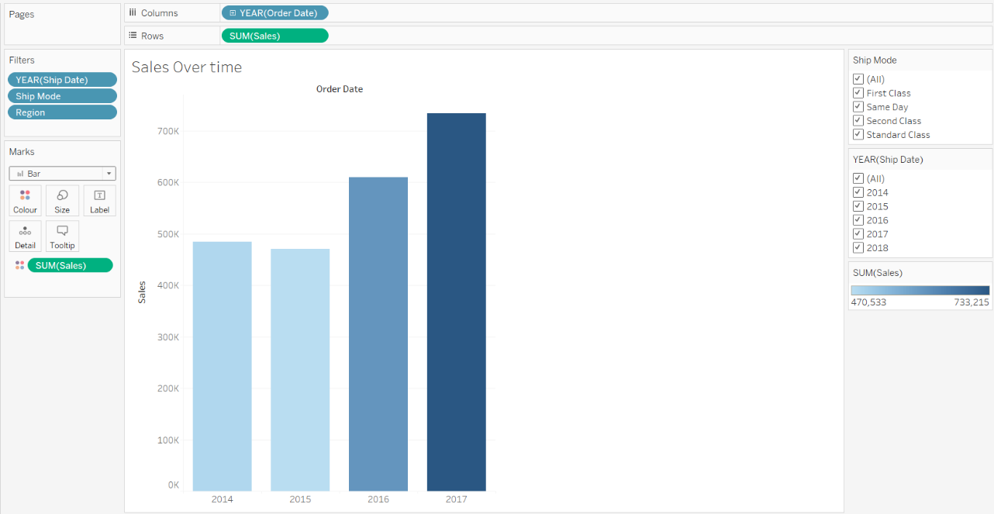
Sales Over Time – Data Analysis
Line graph showing annual sales trends over four years.
Highlights fluctuations and patterns in sales over time.
Provides insights into seasonal variations and overall sales performance.
Abdullahi Mohamed: M00810926

Slide 4
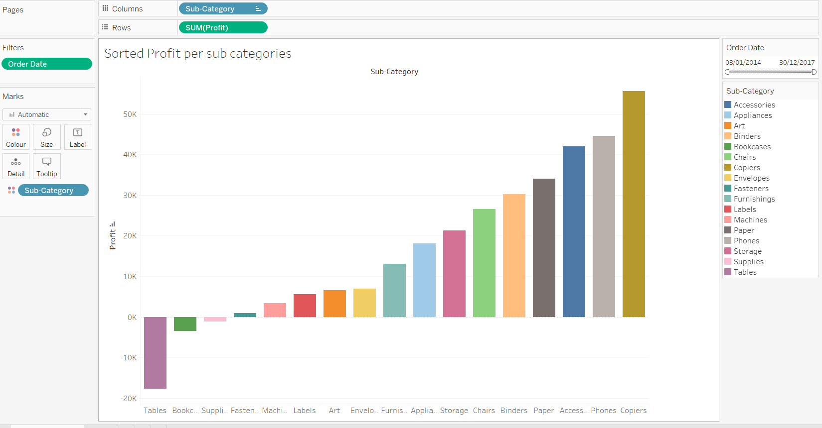
Profits By Sub- Category – Data Analysis
Bar chart illustrating profitability across various product sub-categories.
Helps identify high-performing and underperforming regions.
Offers insights into profit trends and opportunities for improvement.
Abdullahi Mohamed: M00810926

Slide 5
Data Mining Algorithm - Clustering
Chose clustering with SimpleKMeans algorithm for uncovering natural groupings within sales dataset.
Enables identification of similar patterns and behaviors among customers, products, or regions.
Facilitates segmentation and targeted strategies by efficiently partitioning data into clusters based on similarity.
Provides meaningful insights for informed business decision-making.
Abdullahi Mohamed: M00810926

Slide 6
Data Mining - Weka
Utilized K-means clustering algorithm for data mining.
Partitioned dataset into clusters based on similarity.
Identified distinct groups within the data.
Explored patterns and relationships among sales, profit, quantity, and other attributes.
Evaluated clustering performance using within-cluster sum of squared errors (WCSS).
Iteratively refined clustering process to improve model fit and interpretability.
Abdullahi Mohamed: M00810926

Slide 7
Data Mining – Superstore
Implemented K-means clustering to identify natural groupings in the superstore sales dataset.
Utilized clustering to segment customers, products, and regions based on similarity.
Extracted insights into customer behavior, product performance, and regional sales trends.
Leveraged clustering for strategic decision-making and business intelligence.
Removed rows to get more accurate findings of the dataset.
Abdullahi Mohamed: M00810926

Slide 8
Conclusion on Coursework 2
Focusing on comprehensive data analysis and visualization techniques, notably employing K-means clustering.
It effectively addressed the learning objectives by critically evaluating business intelligence concepts and applying modern tools.
This presentation enhanced skills in data-driven decision-making and professional communication.
It has met its objectives, significantly improving proficiency in business intelligence and data analysis.
Abdullahi Mohamed: M00810926

